Slide 1
Upgrading from AngularJS 1 to Angular 2+
Jake Adams

Slide 2
About Me
Jake Adams
Father / Husband
Senior Software Architect - Thompson Coburn LLP
twitter - @jacobladams
http://github.com/jacobladams

Slide 3
Overview
Why / Migration Options
Prepping for Migration
Style Guide / Best practices
TypeScript
WebPack Build
Migrating using ngUpgrade
Bootstrapping
Switching to Angular CLI
Upgrading / Downgrading Components / Service
Routing

Slide 4
Vocabulary
AngularJS vs. Angular
Upgrade vs. Update vs. Migration

Slide 5
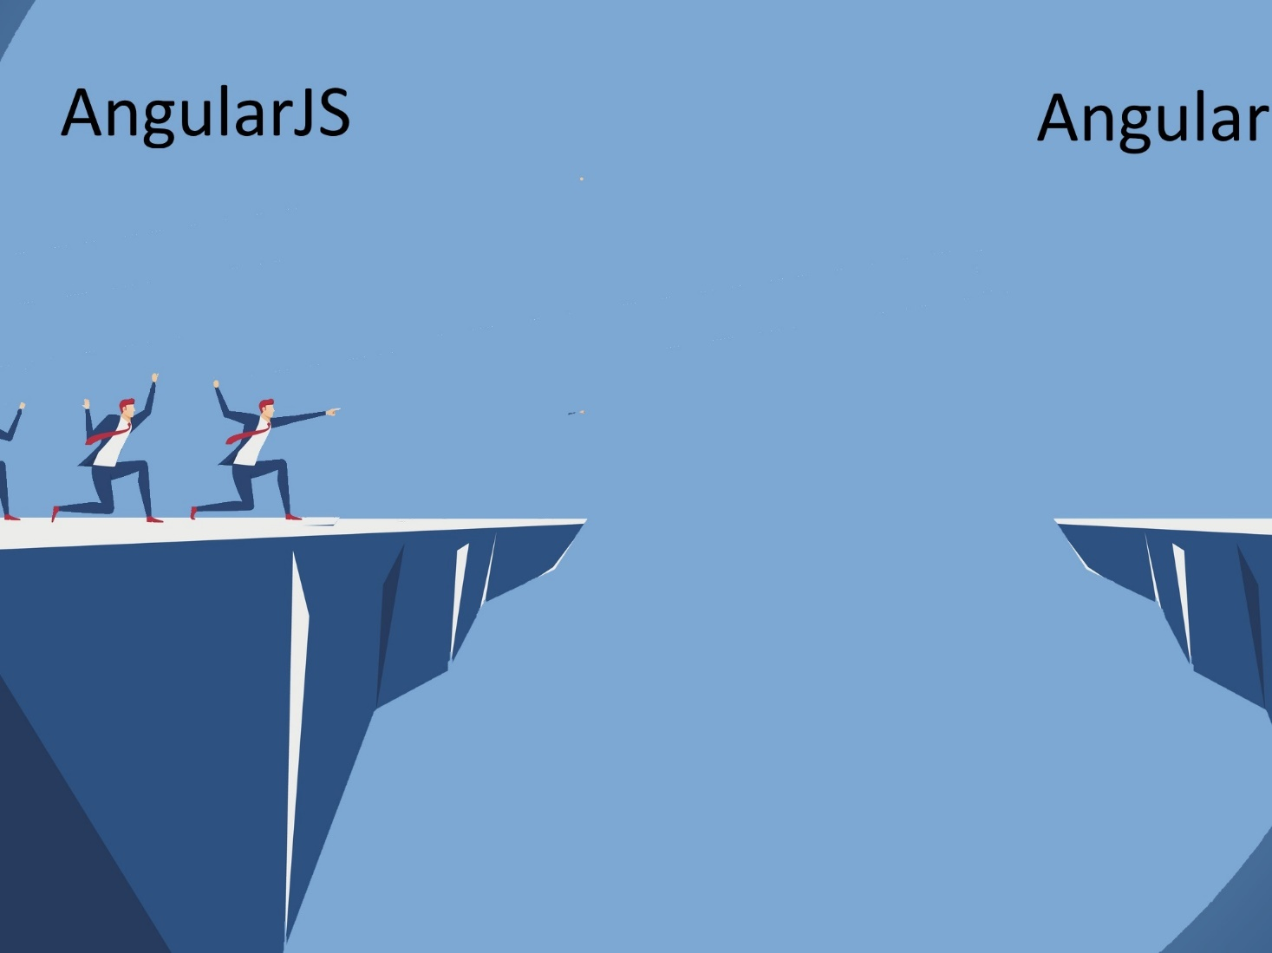

Slide 6
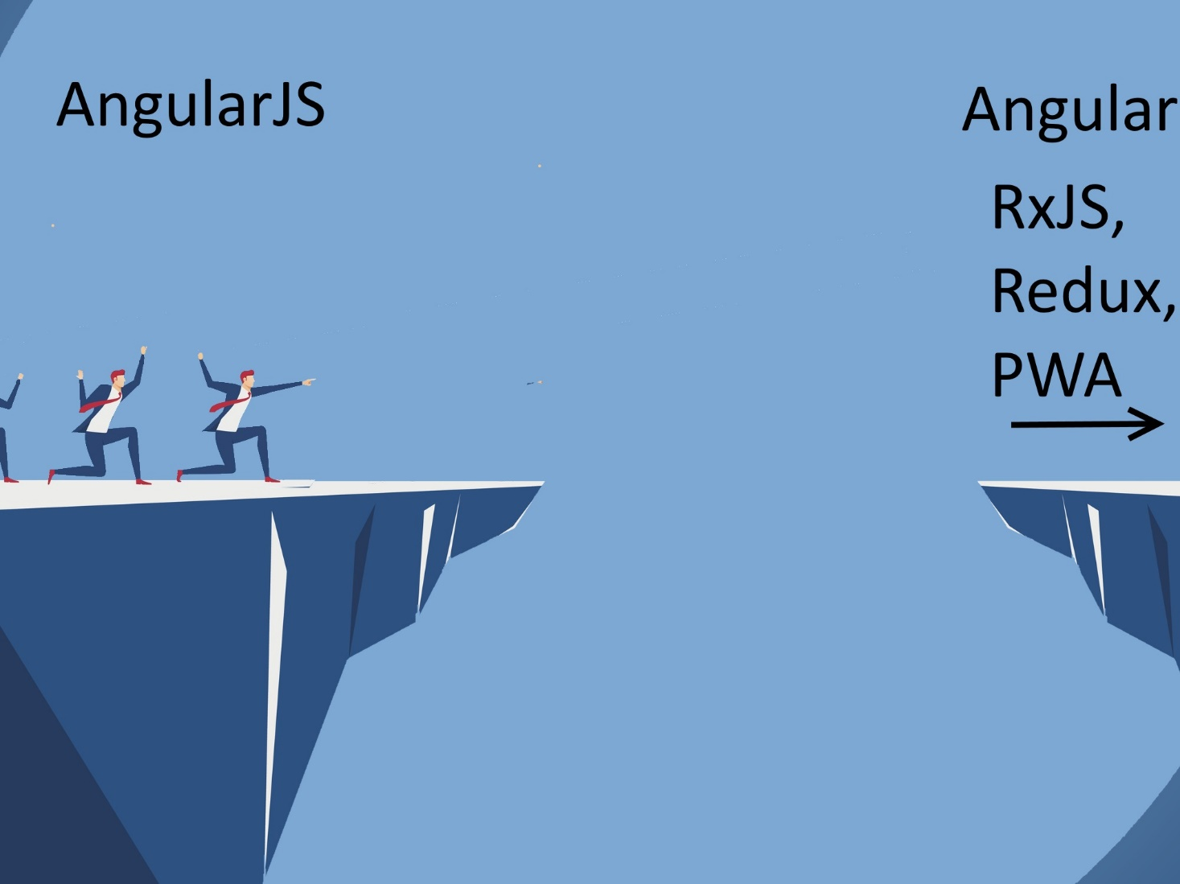

Slide 7
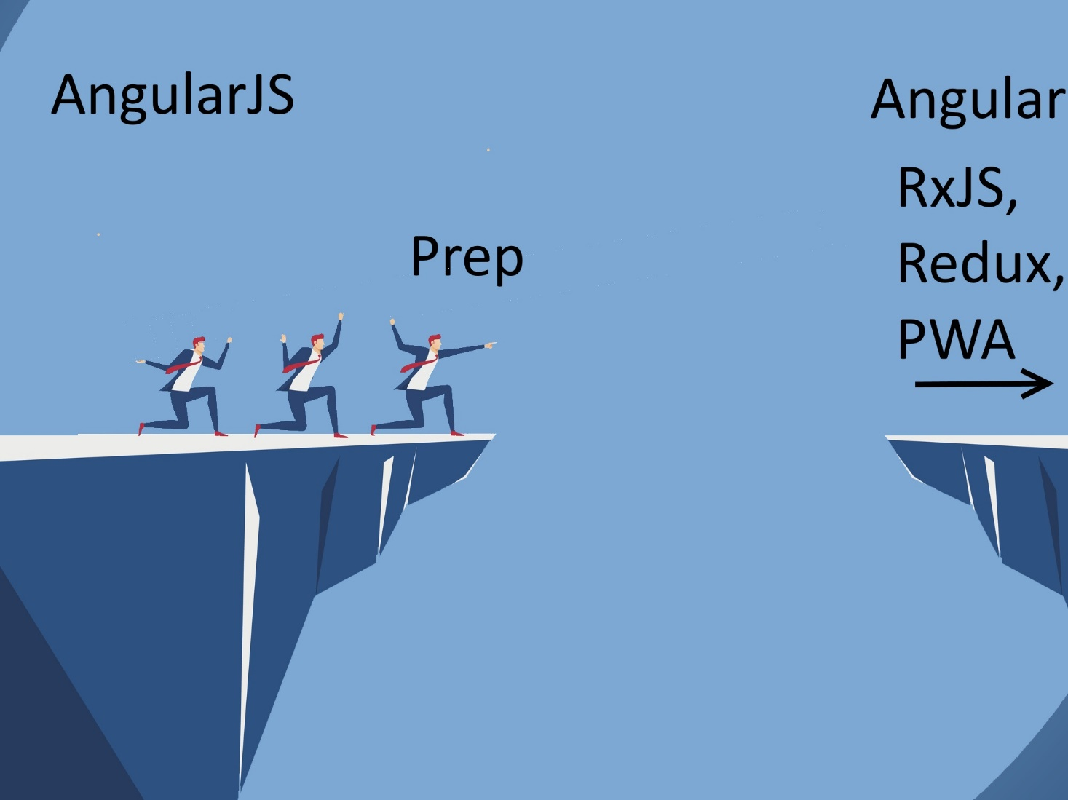

Slide 8
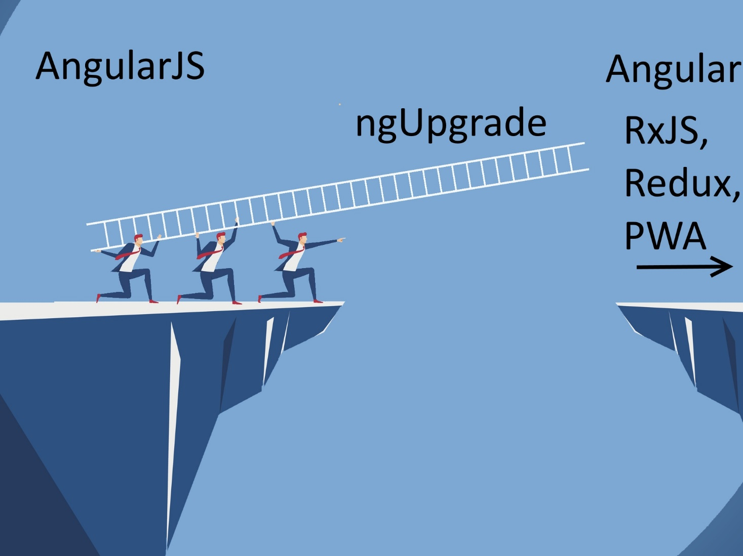

Slide 9
Why Angular 2
Faster
Simpler
Future Focused / Compliant
JavaScript Modules
Web Components
Additional Features
RxJS/Redux/NgRx
Server Side Rendering
Service Workeres / Progressive Web Apps

Slide 10
But I Don’t Want To!

Slide 11
Option #1: Stay on Angular JS 1.X
AngularJs 1.7.X
Jan 1 – June 30, 2018 – Active Development
Jul 1 2018 – June 30, 2021 Long Term Support (LTS)
On July 1st 2018, … we will focus exclusively on providing fixes to bugs that satisfy at least one of the following criteria:
A security flaw is detected in the 1.7.x branch of the framework
One of the major browsers releases a version that will cause current production applications using AngularJS 1.7.x to stop working
The jQuery library releases a version that will cause current production applications using AngularJS 1.7.x to stop working.
Related Blog Post

Slide 12
Option #2: Go to Another Framework
React
Vue
Ember
Aurelia
Knockout
Hyperapp
Polymer
Backbone

Slide 13
Ok, fine. I’ll migrate

Slide 14
Migration Options
Rewrite
ngUpgrade

Slide 15
What is ngUpgrade
Let’s Angular 1 and Angular 2+ interoperate
Provides functionality to “upgrade” and “downgrade” components and services.
Upgrade – Take Angular 1 thing and make it available in Angular 2
Downgrade – Take Angular 2 thing and make it available in Angular 1

Slide 16
Why ngUpgrade
Keeps system deployable
Reduce risk
Steady upgrade

Slide 17
Cons
Have to load both frameworks
Slower overall time

Slide 18
Demo Architecture

Slide 19
Bootstrap

Slide 20
Service

Slide 21
Angular CLI

Slide 22
Components

Slide 23
Components - 2

Slide 24
All Components and Services

Slide 25
Router

Slide 26
All Routes

Slide 27
Further Steps
RxJS
Redux
Lazy Loading
Progressive Web App (PWA)
Plenty Others

Slide 28
Additional Resources / Questions
Pluralsight couses
Preparing for Migration from AngularJS (1.x) to Angular (2+)
Migrating Applications from AngularJS to Angular
Webinar – Strategies for migrating in Angular
Angular Docs – Upgrading from AngularJS to Angular
Dor Moshe - Angular v4: Hybrid Upgrade Application
Rangle.io - Migrating Angular 1.x Projects to Angular 2

